Slide 1

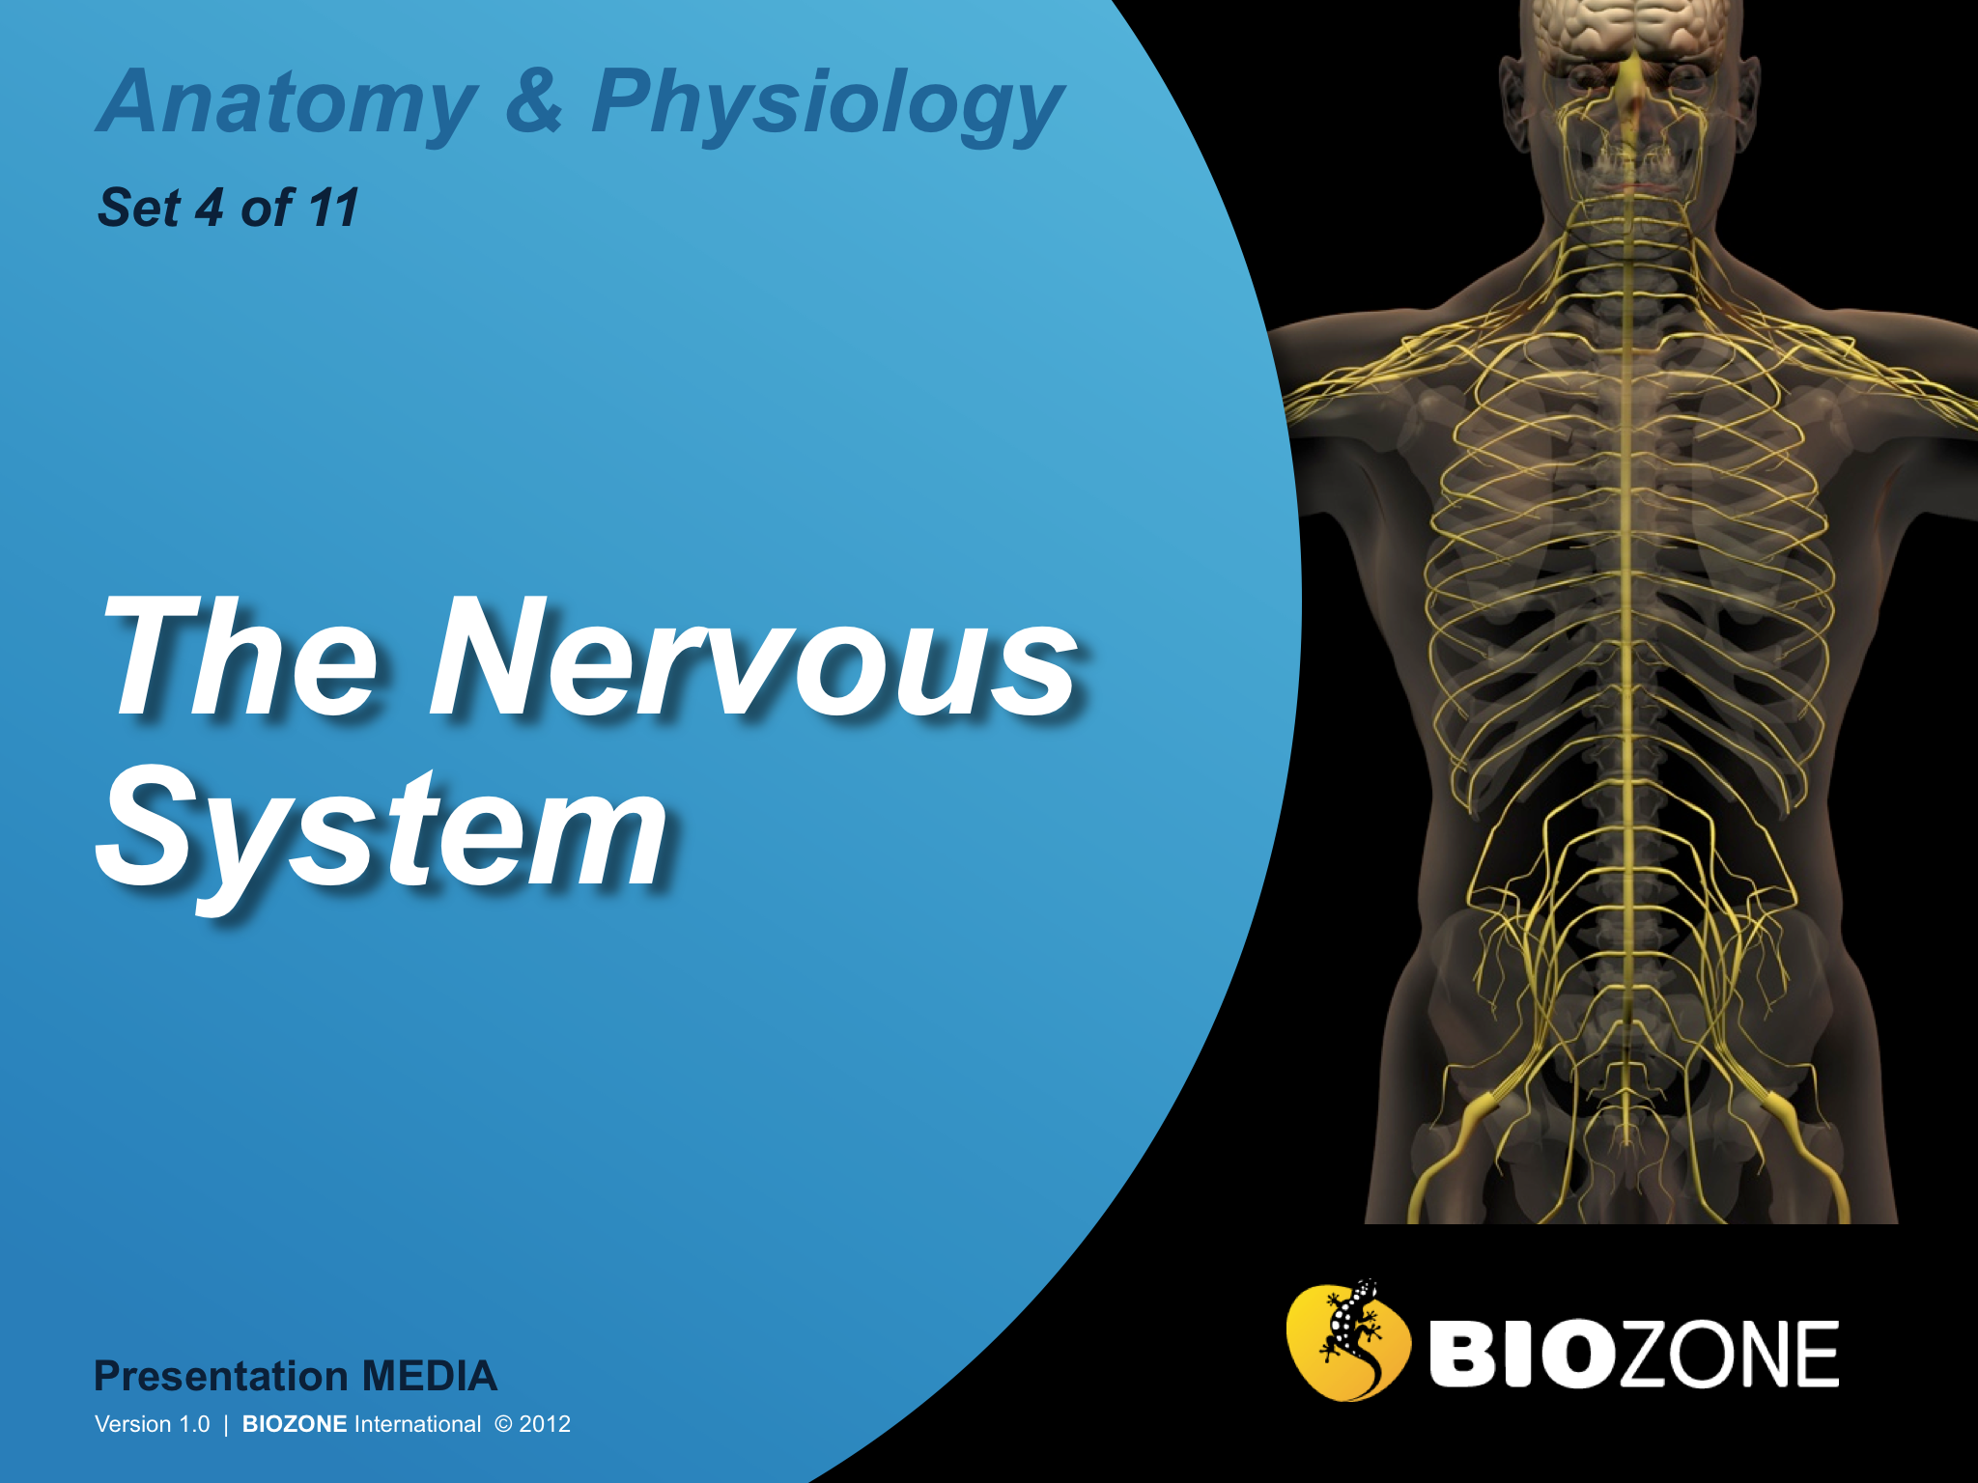

Slide 2
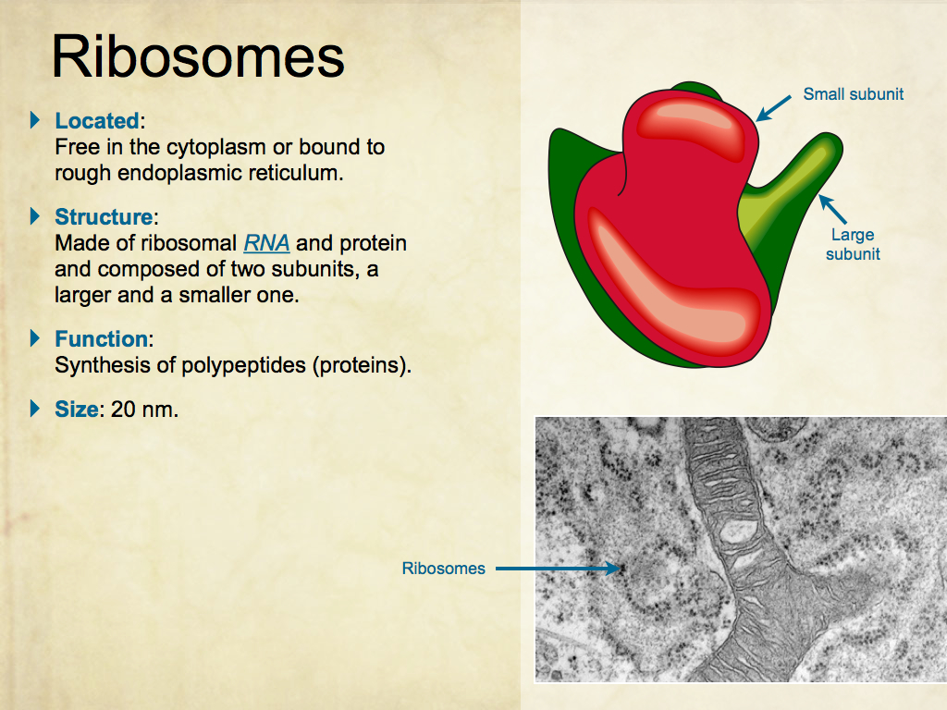
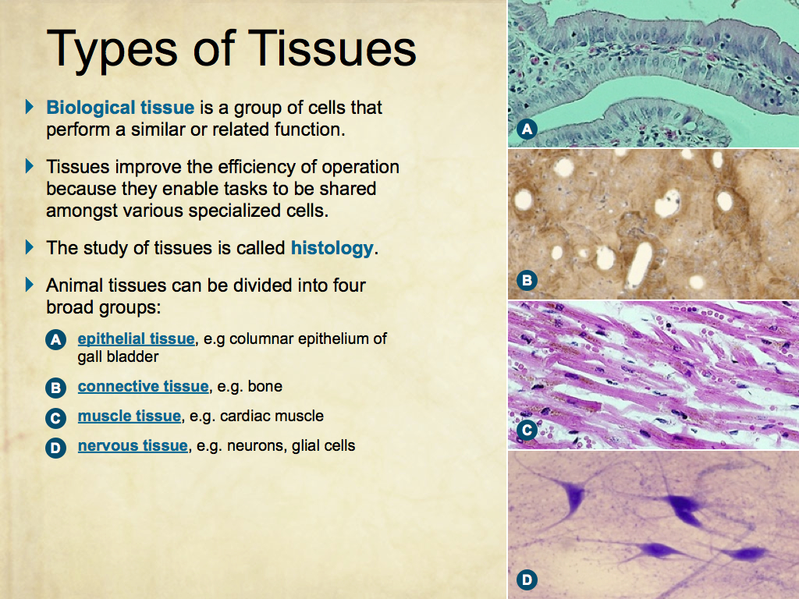
Using Presentation Media
BIOZONE Presentation Media
can be used either as a simple slide show or as an interactive lesson.
  Hyperlinks within the text take you to related slides.
Italicized hyperlinks link to the glossary of definitions.
Bold hyperlinks give direct access to specific slides.

Slide 3
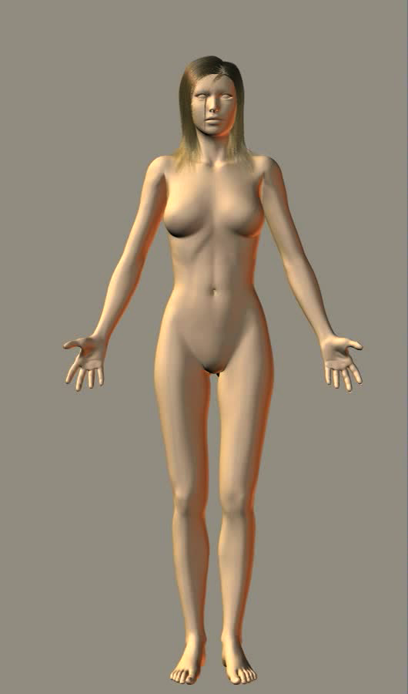
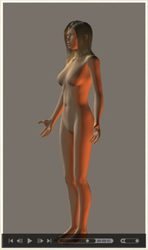
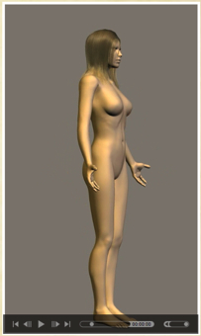
Using Presentation Media
BIOZONE Presentation Media can be used either as a simple slide show or as an interactive lesson
  The movie player allows you to rotate objects.
The movie loops continuously when activated
Use the movie controls in Keynote or Powerpoint
Pause the movie, then drag the slider to rotate the object back and forth

Slide 4
Introduction
  Interacting systems
  Contexts
Control and Coordination
  Control and coordination
  The nervous system
  Peripheral nervous system
  Autonomic nervous system
The Human Brain
  External features
  Internal features
Neurons and Nerves
  Spinal cord
  Nerve cells
  Reflexes
  Impulses and action potentials
  Chemical synapses
Disease
  Diseases, symptoms, and treatment
Detecting Changes of State
  Receptors
  The eye and vision
  The ear and hearing
  Taste and smell
Glossary

Slide 5
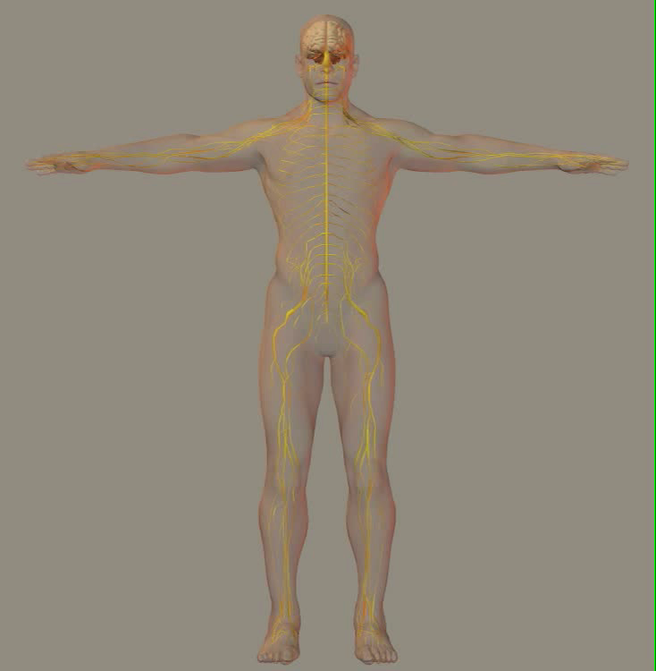
The Nervous System
It is essential for a living organism to detect and respond to changes in the external environment and to regulate its internal environment.
In humans, these tasks are carried out by the endocrine system and the nervous system.
The nervous system comprises cells called neurons (nerve cells) and their supporting cells.
Neurons transmit information in the form of electrochemical impulses called action potentials.
Some nervous activity is involuntary while other activity is voluntary (under conscious control).

Slide 6
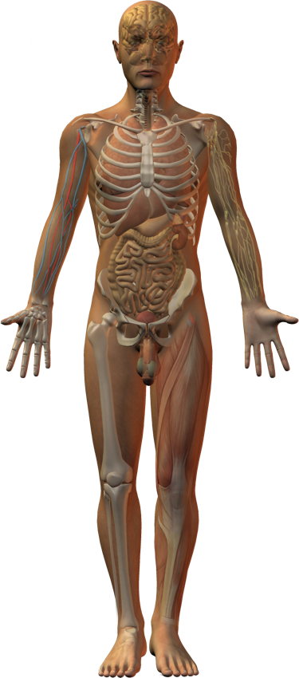
Interacting Systems
Endocrine system
Cardiovascular system
Respiratory system
Lymphatic system and immunity
The nervous system is central to the activity of the other organ systems by providing either autonomic or voluntary control over them.
Neurons send information (in the form of nerve impulses) from receptors throughout the body to the central nervous system (CNS).
The CNS processes the information and coordinates an appropriate response by muscles or glands.
Urinary system
Digestive system
Reproductive system
Integumentary system
Muscular system
Skeletal system

Slide 7
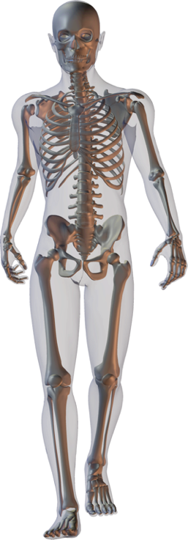
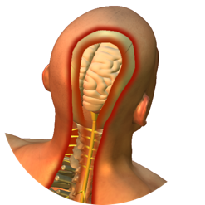
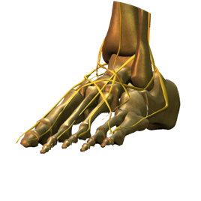
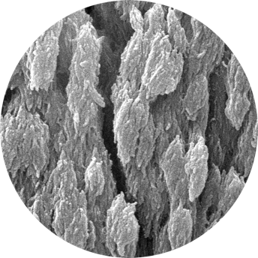
Skeletal System
The nervous system interacts with the skeletal system.
  The skeleton protects the nervous system, especially the brain and spinal cord.
  Nerves innervate bones.
  The skeleton is a source of calcium ions for nerve function.
sbertazzo
Bone mineral

Slide 8
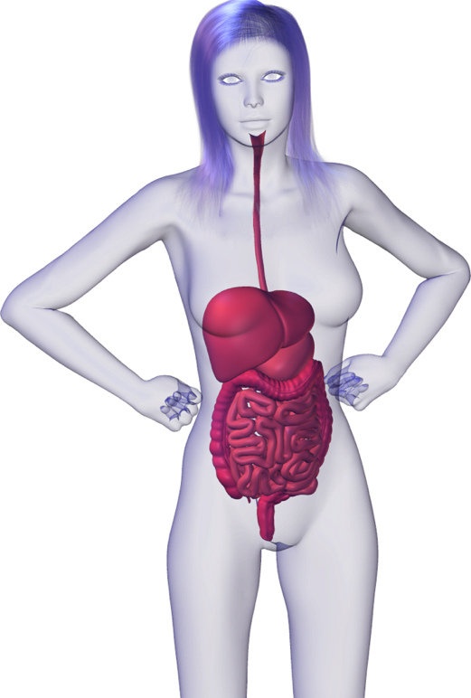
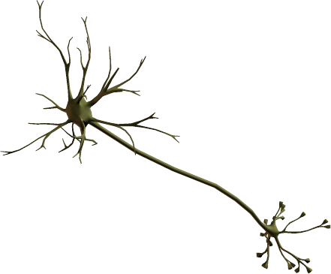
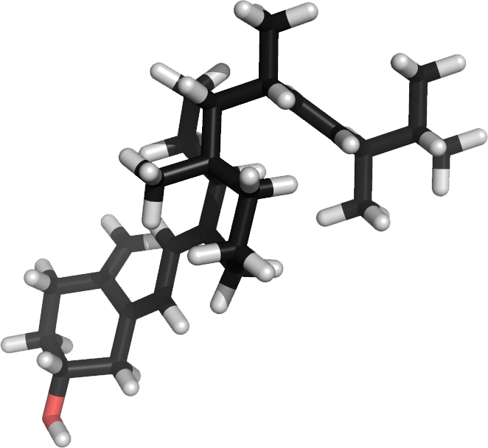
Digestive System
The nervous system interacts with the digestive system.
  Digestion is regulated by the autonomic nervous system (the involuntary branch of the peripheral nervous system).
  Bioactive vitamin D is needed to absorb calcium from the diet. Calcium is essential for nerve cell function.

Slide 9
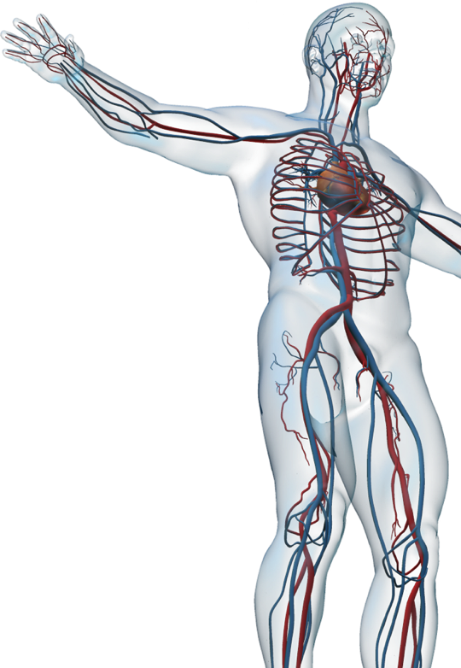

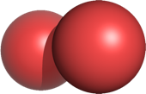
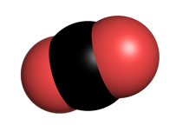
Cardiovascular System
The nervous system interacts with the cardiovascular system.
  Autonomic nervous system regulates heart rate and blood pressure.
  Cardiovascular system delivers oxygen to and removes carbon dioxide and other metabolic wastes from nerve cells.
O2
CO2

Slide 10
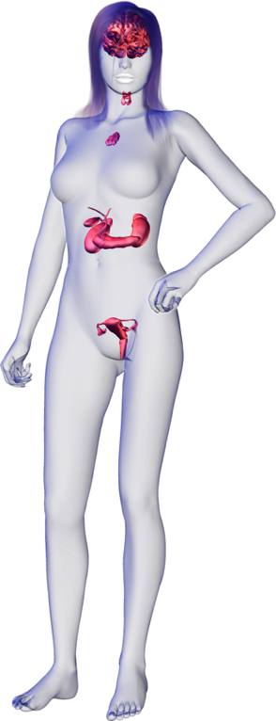

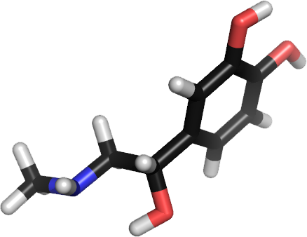
Endocrine System
The nervous system interacts with the endocrine system.
  Sympathetic nervous system stimulates the release of fight or flight hormones from the adrenal glands.
Epinephrine

Slide 11
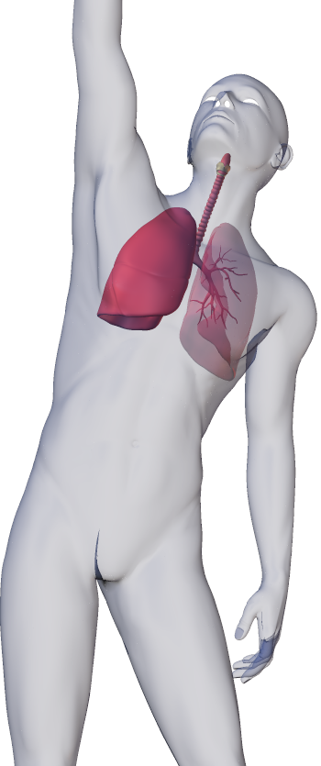

Respiratory System
The nervous system interacts
with the respiratory system.
  Nervous system regulates breathing.
  The respiratory system provides for the exchange of gases, bringing in oxygen and removing carbon dioxide from the nerve cells.
O2
CO2

Slide 12
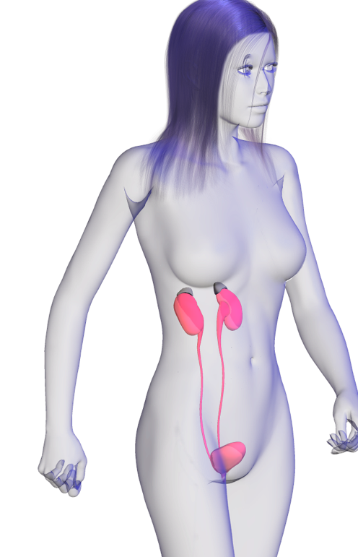
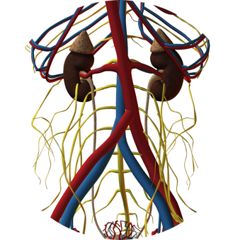
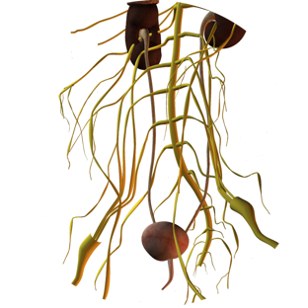
Urinary System
The nervous system interacts with the urinary system.
  Autonomic nervous system regulates renal blood pressure.
  Bladder emptying is regulated by both the autonomic and voluntary activity (control of the urethra sphincter).

Slide 13
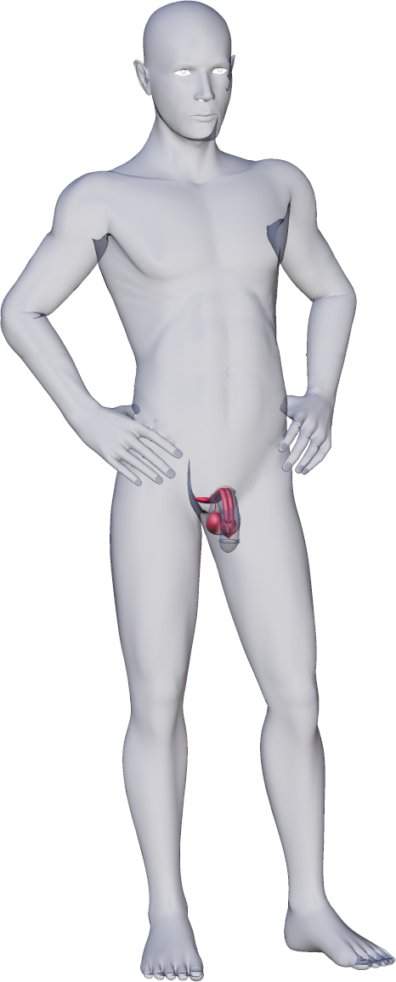
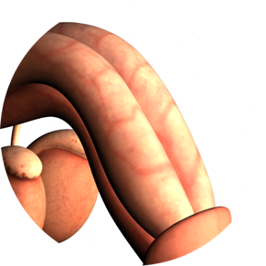
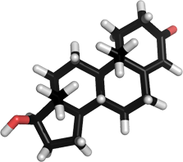
Reproductive System
The nervous system interacts
with the reproductive system.
  Autonomic activity regulates erectile tissue in males and females and ejaculation in males.
  Testosterone masculinizes the brain and underlies aggressive behavior.

Slide 14
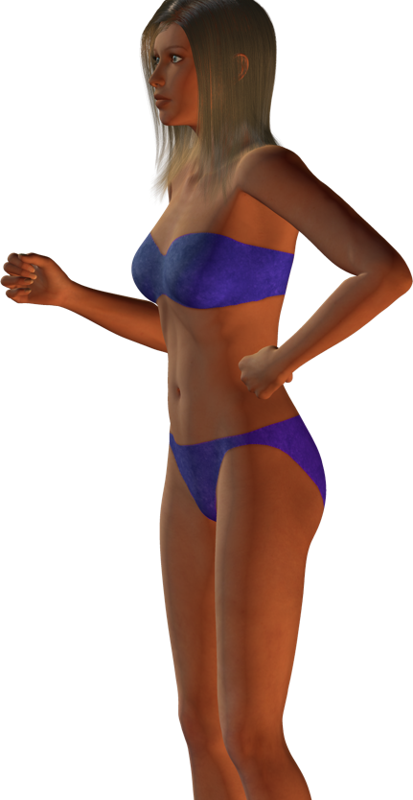
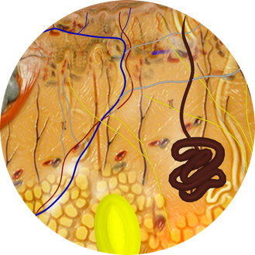
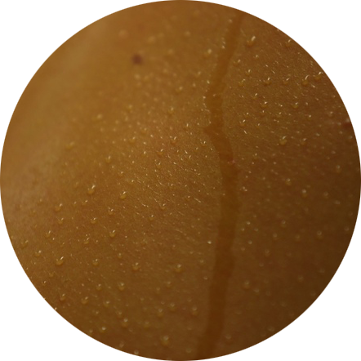
Integumentary System
The nervous system interacts with the integumentary system.
  Sympathetic nervous system activity regulates sweat glands and blood vessels in the skin (thermoregulation).
CA

Slide 15
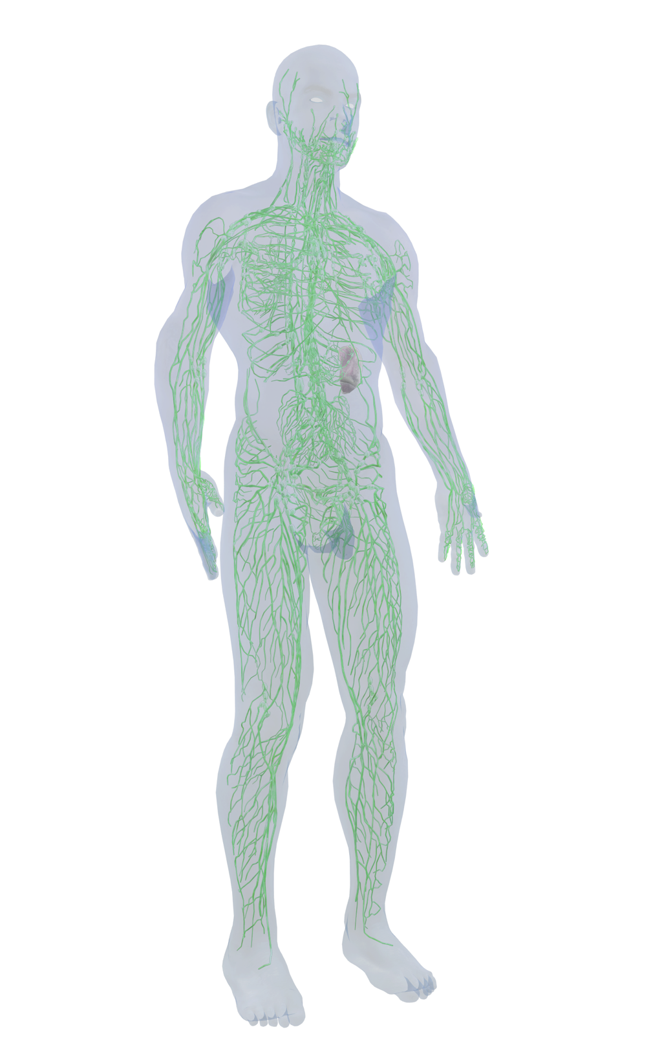
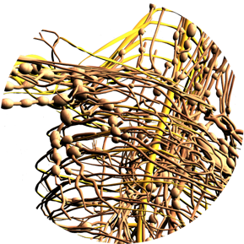
Lymphatic System
The nervous system interacts with the lymphatic system.
  Nervous system innervates lymphatic tissues and regulates immune system response.

Slide 16
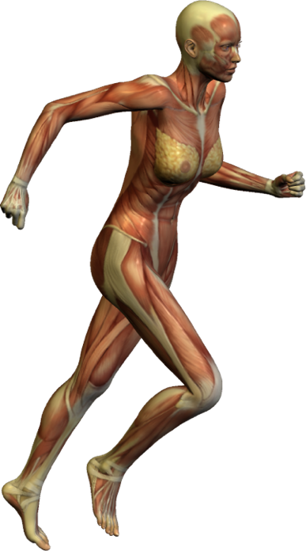
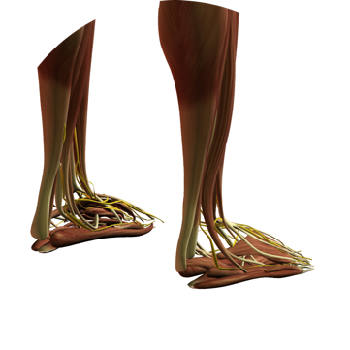
Muscular System
The nervous system interacts with the muscular system.
  Somatic nervous system (the voluntary branch of the peripheral nervous system) controls skeletal muscle activity.

Slide 17
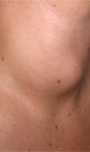
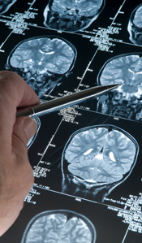
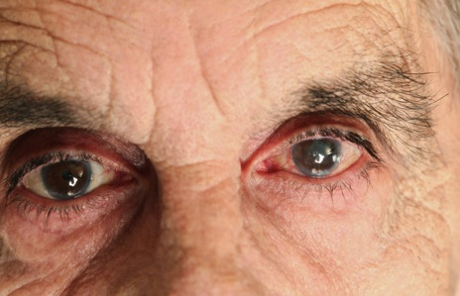
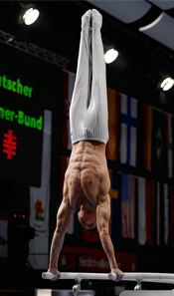
Contexts
Disease
What are the
diseases of the
nervous
system and
what are their
symptoms?
Medicine and Technology
How do we
prevent,
diagnose, and
treat disease of
the nervous
system?
Integration and control
The Nervous System
The nervous system is the essential system for detecting and responding to change in the environment.
Medical technologies can be used to diagnose disorders of the nervous system. The nervous system is affected by exercise and aging.
Drahreg01CC 3.0
iStock
The Effects of Aging
How does
aging affect the
nervous
system.
Exercise
What are the
effects of
exercise on the
nervous
system?
pan Pavel Rycl
iStock

Slide 18

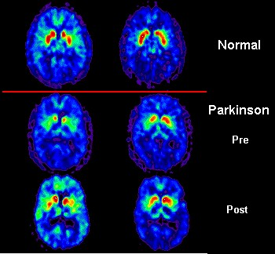
Disease
The nervous system and all other systems are functionally interdependent.
  Diseases of the nervous system can have wide ranging effects on bodily functions and behavior.
Disorders or diseases that damage the functioning of the brain can lead to behavioral problems, memory loss, or an inability to control movements.
Disorders of the nervous system can cause loss of sensation or function, making responding to stimuli or movement difficult.
CA
Headaches and migraines are normally temporary and triggered by a complex series of neural and vascular effects not yet fully understood.
NASA
Parkinson’s disease is a degenerative disease of the central nervous system caused by the death of dopamine generating cells in the substantia nigra (midbrain). The cause of the cell death is unknown.

Slide 19
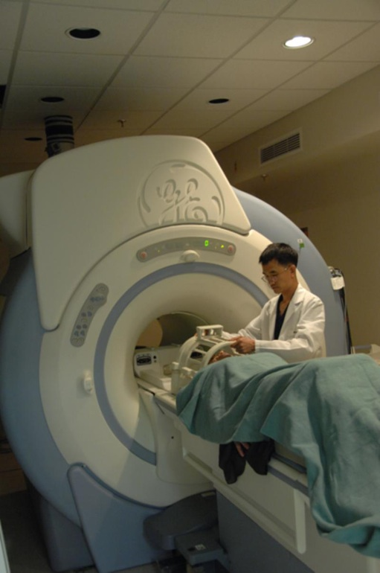
Medicine and Technology
Medical technology has helped to diagnose and understand the causes of many nervous disorders, although for many of these there is still no cure.
Understanding these disorders enables more effective treatment of symptoms and allows practitioners to advise people who are at risk of developing inherited nervous disorders.
Medical imaging techniques such as MRI have enabled accurate diagnosis of the regions of the nervous system affected by disease.
Photo: NIH
MRI scanners allow medical practitioners to identify and diagnose many disorders, especially those associated from the brain.

Slide 20
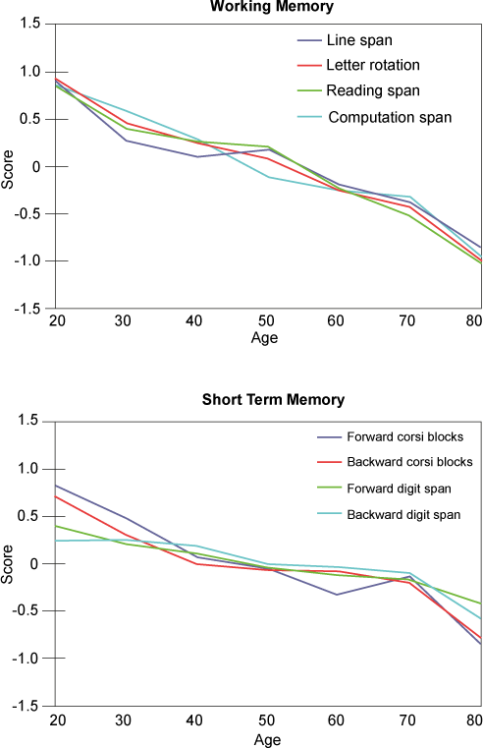
Effects of Age
Aging appears to have major effects on the nervous system, especially as a person reaches the later years of life.
Loss of sensory ability (e.g hearing) is common. Although there is some slowing of thought processes, loss of memory and dementia are not normal aging processes in the brain.
Changes in the nervous system
during aging can affect the functions of other organs.
Park et al 2002
Park et al 2002
Various cognitive tests can be used to assess a person’s mental ability. Working memory (e.g. for computation) and short term memory (e.g. lists) both decline with age.

Slide 21
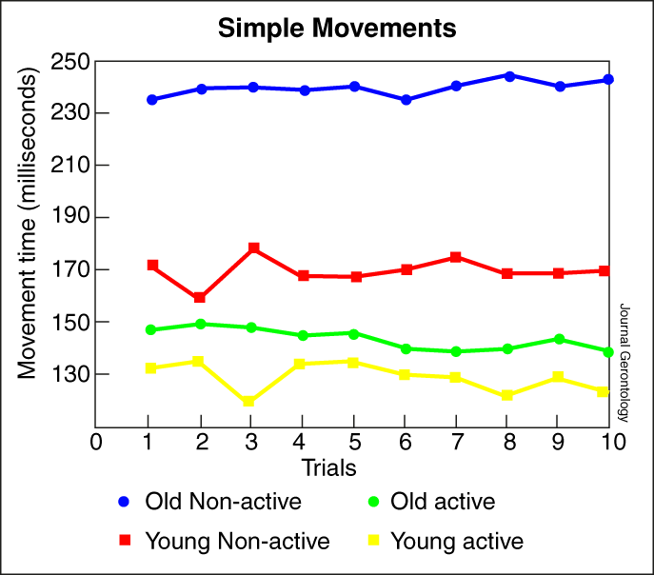
Exercise
Exercise and physical activity are important for the development of the nervous system.
  Repetition of a physical activity helps to improve the ability to carry it out and improves reaction times.
  Exercise also improves coordination. It helps the body become more spatially aware and so helps it carry out complex physical tasks.
Moderate exercise (for more than 30 minutes at a time) can help reduce the effects of aging on the nervous system.
Many studies have shown that remaining active throughout life slows the effects of aging. The graph (above) shows ten trials in which the movement times for simple activities were recorded. Active elderly people were quicker than both their non-active counterparts and young non-active people.

Slide 22


Control and Coordination
The human brain is an extremely complex organ that is capable of receiving information, processing it and determining the correct course of action required, and sending the response signal to the correct part of the body within milliseconds.
  The average human response time is between 0.2 and 0.3 seconds.
  In the example of catching a ball, the eye sends a signal to the brain which reacts by sending signals to the hands and arms to move to catch and hold the ball.
    The brain is able to judge the speed and direction of movement of the ball and place the hands in the correct position to catch it.
Motor cortex coordinates appropriate response
Eye perceives the stimulus and sends a message via sensory neurons to the brain
Motor neurons carry the message to effectors (the muscles in hand and arm)
CA

Slide 23
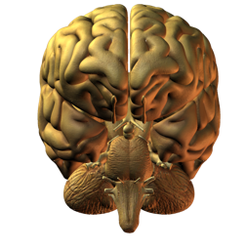
Nervous Coordination
External stimuli
Internal stimuli
Receptors (sense organs)
e.g. eyes, ears, taste buds, stretch and pressure receptors
The nervous system system consists of the central and peripheral nervous systems.
  Sensory input to receptors comes via stimuli.
  Information about the effect of a response is provided by feedback mechanisms so that the system can be readjusted.
Sensory input is received by the sensory structures (via stimuli) and converted into electrical impulses
Impulses are transmitted by sensory neurons to the central nervous system
Brain
Feedback mechanism
Central nervous system
Processes sensory input and coordinates a response (brain and spinal cord)
Motor output: impulses are transmitted by motor neurons to effectors
Muscles and glands bring about appropriate action
Effectors
(muscles and glands)
Response

Slide 24

Nervous vs Hormonal Control
 | Nervous control | Hormonal control
Communication | Impulses across synapses | Hormones in the blood
Speed | Very rapid (within a few milliseconds) | Relatively slow (over minutes, hours, or longer
Duration | Short term and reversible | Longer lasting effects
Target pathway | Specific (through nerves) to specific cells | Hormones broadcast to target cells everywhere
Action | Causes glands to secrete or muscles to contract | Causes changes in metabolic activity
Active movement and response are controlled by the nervous system. Some activities cause rapid changes in hormone levels, such as the release of epinephrine during moments of high stress.

Slide 25
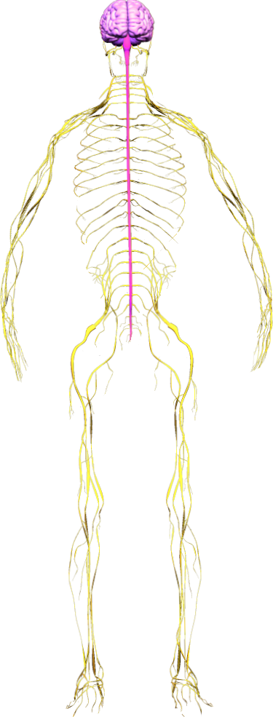
The Nervous System
Brain
CNS
Spinal cord
The nervous system is the body’s control and communication center.
The basic organization of the nervous system can be simplified into a few key components:
  The sensory receptors: detecting stimuli.
  The central nervous system: interpreting stimuli and initiating a response.
  The effectors (muscle and glands): carrying out a response.
For reference, the nervous system is often divided into two parts:
  The central nervous system (CNS) (comprising the brain and spinal cord).
  The peripheral nervous system (PNS) (comprising all the nerves that enter and leave the CNS).
PNS

Slide 26
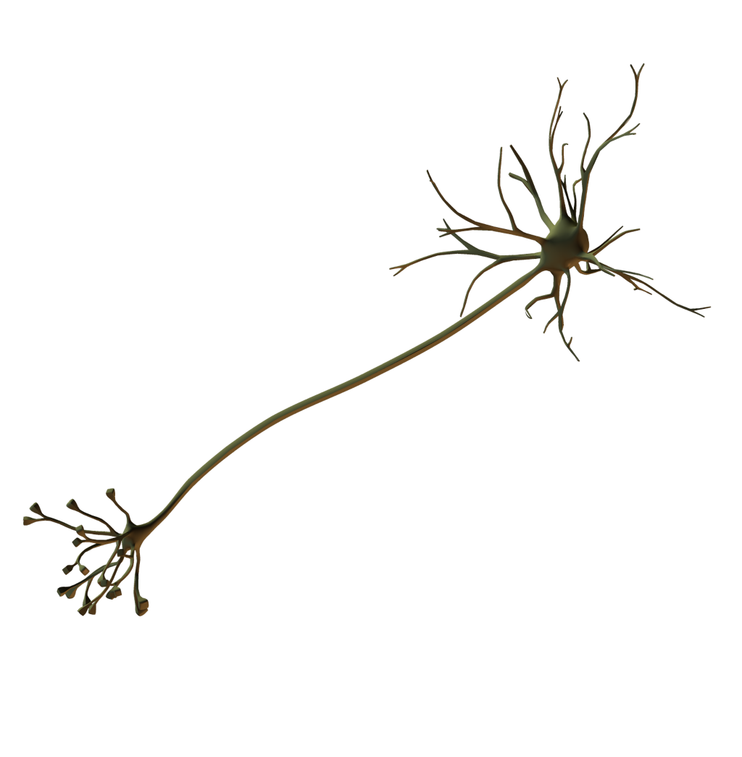
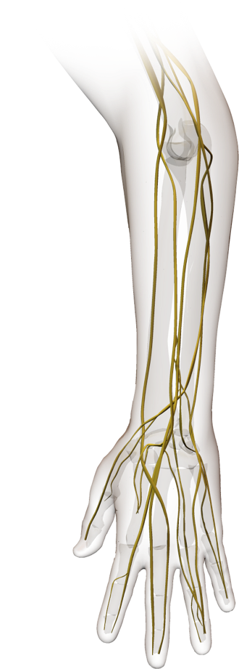
Nerves, Neurons, and Ganglia
Although many people use nerves and neurons interchangeably, they are not the same.
  Neurons are nerve cells, each one comprising dendrites, axons, and a cell body.
    Neurons are classified as sensory, motor, or relay neurons.
  Nerves are bundles of neuron axons in the peripheral nervous system.
    Nerves can be classified as afferent (sensory axons) or efferent (motor axons), or mixed (comprising both afferent and efferent axons).
A ganglion is a tissue mass. It is most commonly associated with a mass of nerve cell bodies.
  Ganglia often provide relay points between different neurological parts of the body.
Neuron (nerve cell)
Nerves in arm

Slide 27
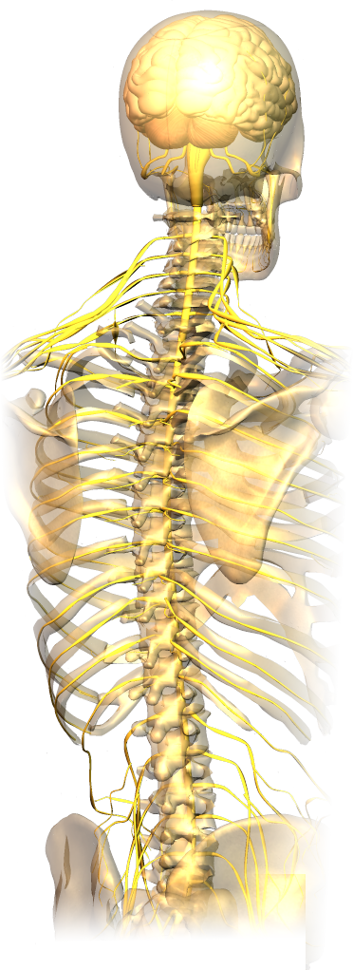
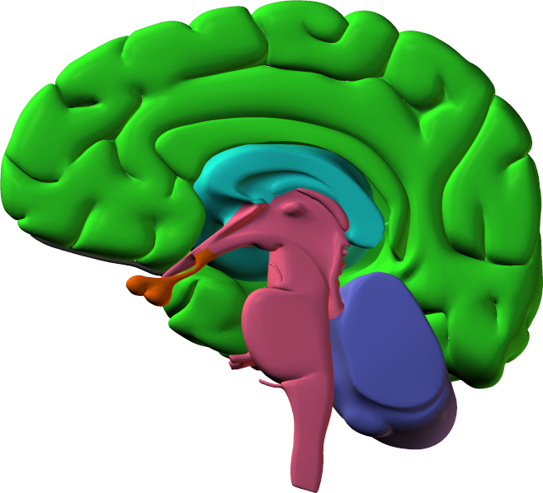
Central Nervous System
The CNS comprises the brain and the spinal cord.
The three most obvious structures in the brain are:
  the cerebral hemispheres (thought integration)
  the cerebellum (motor coordination, equilibrium, and balance)
  the brain stem (heartbeat, respiration, blood pressure).
The spinal cord is a cylinder of nervous tissue extending from the base of the brain down the back, protected by the bones of the spinal column.
  It transmits signals to and from the brain and controls spinal reflexes.
Spinal cord
Cerebrum
Thalamus
Pituitary
Brain stem
Cerebellum

Slide 28
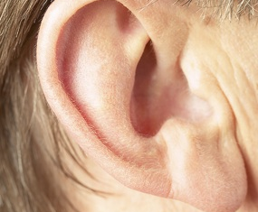
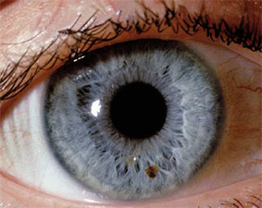


Peripheral Nervous System
The PNS comprises sensory and motor divisions
  Peripheral nerves all enter or leave the CNS, either at the spinal cord (spinal nerves) or the brain (cranial nerves).
  They can be sensory, motor, or mixed.
Ear
Eye
Smooth muscle
Skeletal muscle
AT
EII
EII
Sensory Division
Sensory nerves arise from sensory receptors and carry messages to the CNS for processing.
The sensory system keeps the CNS aware of the external and internal environments. This division includes sense organs such as ears, eyes, and taste buds, as well as internal receptors for monitoring thirst, hunger, and body position.
Motor Division
Motor nerves carry impulses from the CNS to effectors: muscles and glands. The motor division comprises two parts.
Somatic nervous system: the neurons that carry impulses to voluntary (skeletal muscles)
Autonomic nervous system: the neurons that regulate visceral functions over which there is generally no conscious control, e.g. heart rate, pupil reflex.

Slide 29


Autonomic Nervous System
The autonomic nervous system regulates involuntary visceral functions through reflexes.
Most visceral effectors receive fibers from both branches of the ANS, the sympathetic and parasympathetic divisions.
  These two branches have broadly opposing actions on the organs they control.
    Neurons in the parasympathetic division release the neurotransmitter acetylcholine which is rapidly deactivated at the synapse, and its effects localized.
    Neurons in the sympathetic division release the neurotransmitter norepinephrine which enters the blood stream and is deactivated slowly.
    Thus sympathetic stimulation generally has a wider ranging and longer lasting effects than parasympathetic stimulation.
The dilation and constriction of the pupil is an involuntary reflex. Sympathetic stimulation causes the pupil to dilate (top), while the parasympathetic stimulation causes it to constrict (bottom).

Slide 30

Divisions of the ANS
Parasympathetic
Sympathetic
Brain
The parasympathetic division of the autonomic nervous system includes nerves from the brainstem and sacral (S) regions.
  The neurotransmitter is acetylcholine.
The sympathetic division of the ANS includes nerves from the thoracic (T) and lumbar regions (L).
  The neurotransmitters are acetylcholine and epinephrine.
Vagus nerve
T1
Spinal cord
T12
L1
S

Slide 31

ANS: Sympathetic Division
Iris of eye, salivary glands: dilates pupil and decreases secretion of glands.
Brain
T1
Heart and lungs: increases heart rate, constricts coronary blood vessels. Dilates bronchial muscle.
Liver, stomach, small intestine, pancreas: decreases peristalsis (slows motility), promotes sugar release from liver, inhibits insulin and enzyme secretion.
Spinal cord
Large intestine: decreases peristalsis (slows motility).
T12
L1
Bladder and genital organs: causes relaxation of bladder wall, stimulates pregnant uterus to contract, stimulates ejaculation.
Ganglia are close to spinal cord: preganglionic nerves are short, postganglionic nerves are long.
Preganglionic nerves
Postganglionic nerves

Slide 32
ANS: Parasympathetic Division
Iris of eye, tear glands, salivary glands: constricts pupil, stimulates secretion of the glands.
Brain
Vagus nerve
Heart and lungs: slows heart rate, dilates coronary blood vessels, constricts bronchial muscle.
Liver, stomach, small intestine, pancreas: increases peristalsis (motility), promotes sugar storage, and insulin and enzyme secretion.
Spinal cord
Large intestine, bladder, genital organs: increases peristalsis, causes contraction of bladder wall, stimulates genital erection in both sexes and vaginal secretion in females.
S
Preganglionic nerves
Ganglia are in or near the organ: preganglionic nerves are long, postganglionic nerves are short.
Postganglionic nerves

Slide 33


The Human Brain
The brain is one of the largest organs in the body and is protected by the skull, the meninges, and the cerebrospinal fluid (CSF).
The human brain is noted for it well developed cerebrum (cerebral hemispheres), with many folds (gyri) and grooves (sulci).
  Each cerebral hemisphere has an outer layer of gray matter and an inner layer of white matter, and is divided into four lobes by deep sulci or fissures.
Gyri
Sulci
Position of brain in skull

Slide 34


External Features and Lobes
Frontal lobe: speech, movement and personality.
Parietal lobe: bodily sensations, e.g. touch, pain and temperature.
Gyri
Sulci
Temporal lobe: sound recognition- tone and loudness. Memory storage.
Olfactory nerve
Pituitary gland
Occipital lobe: analyzing and interpreting visual information from signals sent by the eyes.
Right hemisphere
Left hemisphere
Pons: upper part of brainstem
Cerebellum: timing and accuracy of skilled movements. Balance and orientation.
Brainstem: most inferior part of the brain. Mainly responsible for autonomic functions.
Anterior view
Left Lateral View of Brain

Slide 35

Sensory and Motor Regions 1
Primary somatic sensory area receives sensations from receptors in the skin, muscles and viscera, allowing recognition of pain, temperature, or touch. Sensory information from receptors on one side of the body crosses to the opposite side of the cerebral cortex. The size of the
sensory region for different body
parts depends on the number of
receptors in that particular
body part.
Primary motor area controls muscle movement. Stimulation of a point one side of the motor area results in muscular contraction on the opposite side of the body.
Primary gustatory area interprets sensations related to taste.
Language areas: The motor speech area (Broca’s area) is concerned with speech production. The sensory speech area (Wernicke’s area) is concerned with speech recognition and coherence.
Visual areas within the occipital
lobe receive, interpret, and evaluate
visual stimuli. In vision, each eye views
both sides of the visual field but the brain receives impulses from left and right visual fields separately. The visual cortex combines the images into a single impression or perception of the image.
Olfactory area (smell)
Auditory areas interpret the basic characteristics and meaning of sounds.
Right Lateral View of Brain

Slide 36


Sensory and Motor Regions 2
Neck
Hip
Shoulder
Knee
Head
Trunk
Leg
Trunk
Elbow
Arm
Arm
Hip
Elbow
Forearm
Wrist
Hand
Hand
Fingers
Thumb
Fingers
Neck
Thumb
Brow
Eye
Eye
Nose
Cerebrum
Toes
Face
Cerebrum
Face
Lips
Genitals
Lips
Teeth
Jaw
Gums
Jaws
Tongue
Tongue
Swallowing
Pharynx
Cerebrum
Cerebrum
LA
LA
Primary somatosensory cortex. The diagram shows the parts of the body and their respective reception areas in the somatosensory cortex of the brain.
Primary motor cortex. The diagram shows the parts of the body controlled by the various areas of the motor cortex.

Slide 37
Internal Brain Structure
Cerebrum: divided into two cerebral hemispheres. Carries out many complex roles. It contains sensory, motor, and association areas, and is involved in memory, emotion, language, reasoning, and sensory processing.
Ventricles: Cavities containing the cerebrospinal fluid, which absorbs shocks and delivers nutritive substances.
Thalamus: the main relay center for all sensory messages that enter the brain before they are transmitted to the cerebrum.
Hypothalamus controls the autonomic nervous system and links nervous and endocrine systems. Regulates appetite, thirst, body temperature, and sleep.
Cerebellum
Brainstem: relay center for impulses between the rest of the brain and the spinal cord. Controls breathing, heartbeat, and the coughing and vomiting reflexes.

Slide 38

Ventricles of The Brain
The brain contains four chambers (ventricles) filled with cerebrospinal fluid (CSF).
  The CSF is produced in the lateral ventricles (one in each hemisphere of the brain)
  It both protects and nourishes the brain and spinal cord.
Inter-ventricular foramen: opening where CSF drains from the lateral ventricle to the third ventricle
Lateral ventricles
Third ventricle
Cerebral aqueduct: tube through which CSF flows from the third to the fourth ventricle.
Fourth ventricle
LA

Slide 39

Circulation in the Brain
There are three layers of membranes (meninges) overlying the brain:
  the double layer outer dura mater (DM)
  the web-like arachnoid mater (AM)
  The inner pia mater (PM).
The cerebrospinal fluid (CSF) lies between the two inner meningeal layers.
  The CSF is formed from the blood by clusters of capillaries (called choroid plexuses) in the roof of each ventricle of the brain.
  CSF is continuously circulated through the ventricles of the brain and the spinal cord before returning to the blood.
CSF is reabsorbed into the blood via projections called arachnoid granulations.
Subarachnoid space
Sinus (cerebral vein)
DM
AM
PM
Choroid plexuses produce CSF
Central canal
LA

Slide 40

Spinal Cord
The spinal cord links the brain with the rest of the body.
  It carries nerve signals to and from the brain, but can bypass the brain with sudden reflex actions as required.
Gray matter: The H-shaped central region of the spinal cord comprising nerve cell bodies, dendrites, and synapses around a central canal filled with CSF.
Sensory nerve fibers: Bundles of sensory fibers enter the spinal cord on the dorsal side.
Direction of nerve impulse
Dorsal
Central canal
Motor nerve fibers: Bundles of motor fibers leave the spinal cord on the ventral side.
White matter: The outer region of the spinal cord containing nerve fibers.
Ventral
LA

Slide 41

Cells of Nervous Tissue
Nervous tissue is made up of two main
cell types:
  Neurons, which transmit nerves impulses (action potentials).
    Motor, sensory, and relay neurons
  Supporting cells called neuroglia
    Astrocytes, ependymal, microglia, oligodendrocytes
Neurons Are long slender cells comprising a cell body and long processes (dendrites or axons).
  Most neurons in the peripheral nervous system are also supported by a fatty tissue called myelin.
Neuroglia are more variable and are specialized to perform different roles.
  Although they appear similar to neurons, glial cells are unable to transmit action potentials.
Neurons
AT
Dendrite
Cell body
Axon
Generalized neuron

Slide 42

Sensory Neurons
Sensory neurons transmit impulses from sensory receptors to other neurons
Sensory receptor(pressure receptor) in the skin.
Two axonal branches, one central (to the CNS) and one peripheral (to the sensory receptor). In complex organisms, sensory neurons relay their information to the central nervous system.
Myelin sheath
Impulse direction
Cell body or soma containing the organelles to keep the neuron alive and functioning.
Node of Ranvier
Axon branches
LA

Slide 43

Motor Neurons
Motor neurons transmit impulses form the central nervous system to muscles or glands.
Dendrites
Cell body
Axon branches have synaptic
knobs at each end. These release neurotransmitter substance, which transmits the impulse between neurons or between the neuron and an effector (e.g. muscle cell).
Impulse direction
Axon hillock: generation of self-propagating nerve impulse or action potential.
Axon: A long extension of the cell transmits the nerve impulse to another neuron or to an effector (e.g. muscle). Axons vary in length from several millimeters to a meter or more (e.g. the sciatic nerve). In the peripheral nervous system, many are myelinated.
Myelin sheath
LA

Slide 44

Relay Neurons
Relay neurons are also called association or interneurons.
They are located in the CNS and carry impulses from sensory to motor neurons (as in reflexes).
Cell body
Dendrites: Bushy extensions of the cell body, specialized to receive stimuli
Axon
Axon branches
LA

Slide 45

Myelinated Neurons
Where conduction speed is important, the axons of neurons are sheathed by a lipid and protein-rich substance called myelin.
  Myelin is produced by oligodendrocytes in the central nervous system and by Schwann cells in the peripheral nervous system.
  Myelin acts as an insulator, preventing the flow of ions across the neuron membrane. This increases the speed at which nerve impulses travel because it forces the current to jump along the axon.
Scwhann cell wraps only one axon and produces myelin
Ion flow
N2
LA
Axon
Node of Ranvier (gap between Schwaan cells): allows a nerve impulse to jump from one point of ion flow across the membrane (N1) to the next (N2). Ion flow occurs only at the nodes so the speed of impulse conduction is increased.
N1
Myelin layers wrapped around axon

Slide 46

Non-Myelinated Neurons
Non-myelinated neurons are relatively more common in the central nervous system where the distances signals travelled are shorter than in the peripheral nervous system.
  Axons are encased in the cytoplasmic extensions of oligodendrocytes or Schwann cells rather than in a myelin sheath.
  The speed of impulse conduction is slower than in myelinated neurons because the nerve impulse is propagated along the entire axon membrane.
Schwann cell wraps several axons and does not produce myelin
Cytoplasmic extensions
Axon
LA
Ion flow across the membrane occurs continuously and consecutively along the entire membrane, slowing down the speed of impulse.
Nucleus

Slide 47

Astrocytes
Astrocytes are the most abundant supportive cells in nervous tissue.
They anchor neurons to capillaries and support the blood-brain barrier by restricting the passage of certain substances.
They are also important in the repair of the brain and spinal cord following injury.
Astrocyte connects capillary and neurons
Capillary
Neuron
Processes cling to capillary walls

Slide 48

Microglial Cells
Microglia are the defense cells of the nervous tissue.
  Antibodies are too large to cross the blood-brain barrier so the phagocytic microglia must be able to recognize and dispose of foreign material and debris.
Spider-like processes
Neuron
Microglial cell
Neuron

Slide 49

Ependymal Cells
Ependymal cells are the epithelial cells lining the ventricles in the brain and the central canal of the spinal cord.
  The surfaces of these cuboidal cells are covered in cilia and microvilli, which circulate and absorb CSF.
  Specialized ependymal cells and capillaries together form the choroid plexuses, which produce the CSF.

Slide 50


Oligodendrocytes
Oligodendrocytes produce insulating myelin sheaths around the axons of neurons in the CNS.
A single oligodendrocyte can extend to wrap around up to 50 axons.
Image: Jurjen Broeke
This image shows an oligodendrocyte genetically altered to fluoresce

Slide 51



Schwann Cells
Schwann cells may be myelinating or non-myelinating.
  Myelinating Schwann cells wrap around axons in the peripheral nervous system, providing insulating sheaths.
  Non-myelinating Schwann cells are involved in maintenance of the axons.
Schwann cells are the functional equivalent of the oligodendrocytes in the central nervous system.
neuron axon
Schwann cell
Schwann cell
Schwann cell nucleus
Neuron axon

Slide 52

Reflexes
Pain Withdrawal: A Polysynaptic Reflex Arc
1
Stimulus: pin prick
A reflex is an automatic response to a stimulus involving a small number of of neurons and a central nervous system (CNS) processing point (usually the spinal cord, but sometimes the brain stem).
  Reflexes permit rapid response to stimuli and are classified according to the number of CNS synapses involved:
    Monosynaptic reflexes involve only one CNS synapse (e.g. knee jerk reflex).
    Polysynaptic reflexes involve two or more CNS synapses (e.g. pain withdrawal reflex).
Sensory neuron
Pain receptors in the skin detect stimulus
Impulse direction
2
Interpretation of sensory message through a relay neuron
Spinal cord
Motor neuron
3
Response: withdraw finger
LA
The impulse reaches the motor end plate and activates muscle contraction

Slide 53


Newborn Reflexes
Normal newborns exhibit a number of primitive reflexes in response to stimuli.
  These reflexes disappear after a few months as the child develops and becomes more able to control its own actions.
  Primitive reflexes include the grasp reflex and the startle (Moro) reflex, in which the infant will suddenly extend its arm and legs and cry in response to a sudden movement.
    The Moro reflex is usually tested immediately after birth by sitting the baby up then letting it drop backwards slightly.
Grasp reflex
Istock
Moro startle reflex
Istock

Slide 54


Other Reflexes
The pupillary light reflex refers to the rapid expansion and contraction of the pupils in response to the intensity of light falling on the retina.
  It is a polysynaptic cranial reflex and can be used to test for brain death.
The patella (knee jerk) reflex is a simple deep tendon reflex that is used to test the function of the femoral nerve and spinal cord segments L2-L4.
  It helps to maintain posture and balance when walking.
Pupillary reflex
Istock
Patella reflex
Istock

Slide 55




The Resting Neuron
When a neuron is not transmitting an impulse, the inside of the cell is negatively charged compared with the outside of the cell.
+
Extracellular fluid
+
+
+
-
-
Na⁺
Na⁺
Na⁺
K⁺
Na⁺
+
+
-
Na⁺
+
-
-
-
-
K⁺
+
-
-
Na⁺
Cl⁻
Cl⁻
Na⁺
-
-
-
-
+
-
+
+
K⁺
Na⁺
-
-
+
Na⁺
Na⁺
Na⁺
Na⁺
+
+
Cl⁻
+
+
Resting neurons are said to be polarized, because the inside and outside of the cell are oppositely charged.
Plasma membrane
Cl⁻
Cl⁻
Cl⁻
Protein
K⁺
PO
3-
The potential difference (voltage) across the membrane is called the resting potential. For most nerve cells is about -70 mv.
Protein
K⁺
K⁺
4
3-
K⁺
PO
4
K⁺
Intracellular fluid

Slide 56

The Nerve Impulse
When a neuron is stimulated, the distribution of the charges on each side of the membrane reverses.
1
For a millisecond, the charges reverse. This process, called depolarization, causes a burst of electrical activity to pass along the axon of the neuron.
Extracellular fluid
Na⁺
Cl⁻
Cl⁻
Na⁺
K⁺
K⁺
Na⁺
K⁺
K⁺
+
+
Cl⁻
+
-
-
+
+
-
+
-
+
-
+
-
+
Plasma membrane
+
-
-
+
+
-
-
-
-
-
-
-
-
+
+
Na⁺
Na⁺
+
Cl⁻
C^{l-}
Cl⁻
+
Na⁺
Na⁺
K⁺
2
As the charge reversal reaches one region, local currents depolarize the next region. In this way, the impulse spreads along the the axon by self propagation as an action potential.
PO4³⁻
Na⁺
K⁺
Na⁺
Protein
K⁺
Na⁺
K⁺
Na⁺
Na⁺
Intracellular fluid

Slide 57


Nerve Impulses
Neurons are electrically excitable cells. This property results from the separation of ion charge (potential difference) either side of the neuronal membrane.
  The most important ions in establishing this potential difference are Na⁺, K⁺, and negatively charged proteins.
Neurons exist in an either resting or stimulated state. When stimulated, neurons produce electrical impulses that are transmitted along the axon.
  These impulses are transmitted between neurons across junctions called synapses.
  Synapses enable impulses to be transmitted rapidly all around the body.
Istock
Istock

Slide 58

The Resting Potential
Membrane potential is governed by the opening and closing of ion channels in the plasma membrane of a neuron.
  The resting potential is established by an unequal distribution of charge with a potential difference of -70mV.
    During the resting phase, a small set of potassium (K⁺) channels are open allowing K⁺ to move across the membrane, although there is no change in polarity.
K⁺
Na⁺
Na⁺
Na⁺
K⁺
Na⁺
Na⁺
Na⁺
K⁺
Na⁺ channel
K⁺ channel
K⁺
Inside neuron
Resting potential
Threshold
Rising
phase
Falling Phase
Recovery

Slide 59
Depolarization
As a stimulus reaches the membrane, a few sodium ion (Na⁺) channels open, depolarizing the membrane and making it less negative.
This brings it closer to the threshold potential.
K⁺
Na⁺
K⁺
Na⁺
Na⁺
Na⁺
Na⁺
K⁺
Na⁺
Na⁺
K⁺
Inside neuron
Resting potential
Threshold
Rising
phase
Falling Phase
Recovery

Slide 60
The Action Potential
If the depolarization reaches the threshold potential, the charge across the membrane quickly reverses as more Na⁺ channels open and allow Na⁺ ions to flood into the cell. This rapid reversal in charge generates the rising phase of the action potential.
K+
K+
Na+
Na+
K+
Na+
Na+
Na+
Na+
Na+
K+
Inside neuron
Resting potential
Threshold
Rising
phase
Falling Phase
Recovery

Slide 61
Repolarization
At the peak of the action potential, the Na⁺ channels close and more K⁺ channels open, allowing K⁺ ions to escape from the cell and begin the reversal of charge.
The membrane potential repolarizes beyond the original resting potential due to a delay in the closing of the K⁺ channels.
  This is called hyperpolarization
K⁺
Na⁺
Na⁺
K⁺
K⁺
K⁺
Na⁺
Na⁺
K⁺
K⁺
Na⁺
Na⁺
Na⁺
Na⁺
Inside neuron
Resting potential
Threshold
Rising
phase
Falling Phase
Recovery

Slide 62
Recovery
The resting potential is restored when the K⁺ channels close, leaving only the original set of K⁺ channels open so that K⁺ ions slowly return to their original proportions on either side of the plasma membrane.
K⁺
K⁺
K⁺
Na⁺
Na⁺
K⁺
K⁺
K⁺
Na⁺
Na⁺
Na⁺
Na⁺
Inside neuron
Resting potential
Threshold
Rising
phase
Falling Phase
Recovery

Slide 63

Chemical Synapses
Action potentials are transmitted between neurons, and between neurons and effectors, across synapses.
Synapses are junctions between the end of one axon and the dendrite or cell body of a receiving neuron.
  Most synapses in the nervous system are chemical synapses.
Synaptic knob
Neurotransmitter
Axon
Istock

Slide 64

Chemical Synapses
Synaptic vessel containing acetylcholine
Synaptic end bulb
Direction of nerve impulse
Muscle action potential
In chemical synapses, the axon terminal is a swollen knob, separated from the receiving neuron or cell by the synaptic cleft.
  The synaptic knob is filled with vesicles containing neurotransmitter substance.
  Different neurotransmitters are associated with different types of neurons (e.g. acetylcholine at the neuromuscular junction).
  Nerve transmission involves the diffusion of the neurotransmitter across the cleft where it interacts with the receiving membrane, resulting in propagation of the nerve signal.
  The response of the receiving cell depends on the nature of the cell itself, its location in the nervous system, and the neurotransmitter involved.
Synaptic cleft
Motor end plate
Sarcolemma (plasma membrane)
Neuromuscular junction
Istock

Slide 65

Cholinergic Synapse
Synapses that release acetylcholine (ACh) are termed cholinergic synapses.
Cholinergic synapses occur at:
  The motor end plate where release of acetylcholine (ACh) causes muscle contraction.
  All preganglionic neurons of the autonomic nervous system where release of ACh causes excitation.
  All postganglionic neurons of the parasympathetic division where it may cause an inhibition of response, e.g. a decrease in heart or breathing rate.
Synaptic cleft
Synaptic knob
Vesicles containing neurotransmitter
LA
Mitochondrion

Slide 66




Transmission at A Synapse
Step 1: Arrival of an action potential at the presynaptic terminal causes an influx of calcium ions and induces the vesicles to release their neurotransmitter into the synaptic cleft.
Ca²⁺
Direction of impulse
Synaptic knob
Na⁺
Axon of the presynaptic neuron
Synaptic vesicles containing neurotransmitters (ACh)
Mitochondria provide energy for active transport.
LA

Slide 67



Neurotransmitter Diffusion
Step 2: The neurotransmitter diffuses across the synaptic cleft to receptors on the postsynaptic membrane. This delays the impulse transmission by about 0.5 ms.
Receptor
Sodium gate
Na⁺
Step 3: The neurotransmitter binds to receptors on the postsynaptic membrane.
LA

Slide 68
Post-Synaptic Response
Step 4: Ion channels in the membrane open, causing an influx of Na⁺. This response may or may not reach the threshold required to generate a nerve impulse.
Receptor
Sodium gate
Na⁺
LA

Slide 69
Deactivation of NT
Step 5: The neurotransmitter is deactivated by the enzyme acetylcholinesterase located on the membrane. Components of the neurotransmitter are actively reabsorbed back into the synaptic knob, recycled, and repackaged.
Acetylcholinesterase
LA

Slide 70
Integration at Synapses
Synapses play a pivotal role in the nervous system’s ability to respond to stimuli and adapt to change.
The nature of synaptic transmission allows for interpretation and coordination (integration) of inputs from many sources.
  These inputs may be both inhibitory and excitatory.
Inhibitory inputs make the interior of the cell more negative (hyperpolarized) meaning the cell is less likely to transmit an action potential.
Excitatory inputs make the interior of the cell less negative (less polarized). The cell is more likely to transmit an action potential.
The sum of all inputs leads to the final response in a post-synaptic cell. Integration at synapses makes possible all the various responses we have to stimuli.
Threshold
Threshold
Threshold
Excitatory input
Threshold not reached
Inhibitory input

Slide 71


Synapses and Summation
The additive effect of nerve impulses on the postsynaptic neuron is termed summation and can happen in two ways:
Presynaptic neuron
1
Temporal summation
Several impulses may arrive at the synapse in quick succession from a single axon. The individual responses are so close together in time that they may sum reach the threshold and produce an action potential in the postsynaptic neuron.
Action potential
Postsynaptic cell
2
Spatial summation
Individual responses from spatially separate axon terminals may arrive simultaneously at different regions on the same postsynaptic neuron. The responses from the different places may sum to reach threshold and produce an action potential.
Presynaptic neuron
Neurotransmitter

Slide 72

Drugs and the Nervous System
Synapses in the peripheral nervous system are classified according to the neurotransmitter they release.
The effect produced by these neurotransmitters depends, in turn, on the type of receptors present on the postsynaptic membrane.
  Ach receptors are classified are nicotinic or muscarinic according to their response to nicotine or muscarine respectively.
  Adrenergic receptors are also of two types, alpha or beta, classified according to their particular responses to specific chemicals.
Ach
  Cholinergic synapses release acetylcholine (Ach)
Epinephrine
  Adrenergic synapses release epinephrine (adrenaline) or norepinephrine (noradrenaline).

Slide 73




Effects of Drugs
Drugs exert their effects on the nervous system by mimicking (agonists) or blocking (antagonists) the action of neurotransmitters at synapses.
Because of the small amounts of chemicals involved in synaptic transmission, drugs that affect the activity of neurotransmitters or their binding sites can have powerful effects, even in small doses.
Different drugs have different effects on the body. Therapeutic drugs are used under strict guidelines to ensure useful and safe effects, but unsafe recreational drugs can produce anything from euphoric feelings to paranoia and hallucinations.

Slide 74

Agonists at Cholinergic Synapses
Nicotine acts as a direct agonist at nicotinic receptors.
  Nicotine binds to and activates acetylcholine (Ach) receptors on the postsynaptic membrane.
  This opens sodium gates, leading to a sodium influx and membrane depolarization.
Some agonists work indirectly at the synapse by preventing Ach breakdown.
Such drugs are used to treat elderly patients with Alzheimer's.
Synaptic cleft
Nicotine binds to Ach receptors and opens Na⁺ gates.
Ach
Membrane of post-synaptic neuron
Sodium gated channel
Post-synaptic neuron
Na+
RESULT: Depolarization and impulse generation

Slide 75

Antagonists at Cholinergic Synapses
Atropine and curare act as antagonists at cholinergic synapses with muscarinic Ach receptors.
  These molecules compete with Ach for binding sites on the postsynaptic membrane, and block sodium influx so that impulses are not generated.
If the postsynaptic cell is a muscle cell, muscle contraction is prevented.
In the case of curare, this causes death by flaccid paralysis.
Synaptic cleft
Atropine and curare bind to Ach receptors but block Na+ gates.
Na+
Membrane of post-synaptic neuron
Sodium gated channel
Post-synaptic neuron
RESULT: No depolarization

Slide 76

Agonists at Adrenergic Synapses
Under normal circumstances, the continued activity of the neurotransmitter norepinephrine (NE) at the synapse is prevented by re-uptake of NE by the presynaptic neuron,
Cocaine and amphetamine act indirectly as agonists by preventing this re-uptake.
The action allows NE to linger at the synapse and continue to exert its effects.
Synaptic cleft
Cocaine prevents reuptake of NE
NE accumulates in the synaptic cleft.
Norepinephrine (NE) blinds α receptor.
Membrane of post-synaptic neuron
Sodium gated channel
Post-synaptic neuron
Na+
RESULT: Neuron keeps firing

Slide 77

Antagonists at Adrenergic Synapses
Therapeutic drugs called beta (β) blockers act as direct antagonists at adrenergic synapses (sympathetic nervous system).
  They compete for the adrenergic β receptors on the post synaptic membrane and block
  impulse transmission.
Beta blockers are prescribed primarily to treat hypertension and heart disorders because they slow the heart rate and reduce the force of contraction.
Synaptic cleft
norepinephrine neurotransmitter
β-blockers compete with norepinephrine for receptor site.
Na+
Membrane of post-synaptic neuron
Sodium gated channel
Post-synaptic neuron
RESULT: Response to NE is blocked or reduced

Slide 78

Symptoms of Disease
Symptoms of disease of the nervous system include:
  Loss of function or control
    Damage to neurons may cause them to fire randomly or inefficiently, resulting in difficulty in controlling both voluntary and involuntary functions.
  Loss of voluntary control
    Loss of nervous control to part of the body (e.g. damage to the spinal cord) can result in paralysis of parts of the body.
  Failure to develop normally.
    Problems in early development of the neural tube may cause disorders such as spina bifida.
    Neural problems later in life may include diseases such as Alzheimer's.
Hemera

Slide 79

Diseases of the Nervous System
Diseases of the nervous system include:
  Inherited diseases
    Some diseases have genetic factors, e.g. Huntington’s disease.
  Traumatic disorders
    Damage to the nervous system can result in impaired movement and sensory reception, e.g. damage to the spinal cord can result in paralysis. Damage to the brain can cause varying degrees of impairment and may be fatal.
  Infection
    Infections, such a meningitis and encephalitis, can damage neurons, causing hearing loss, memory loss, and recurring headaches.
  Tumors
    Tumors, such as brain tumors, can destroy neurons and lead to irreparable damage and even death.
  Degenerative diseases
    Some neural diseases result in progressive deterioration of neural function, e.g. multiple sclerosis is characterized by a progressive loss of myelin around neurons, leading to deterioration in motor function, numbness, and muscle spasms.
PET scan of a brain tumor, seen as a bright mass
Image: NIH

Slide 80


Diagnosis of Disorders
Neural disorders can be diagnosed with:
  Genetic testing and screening
    Some inherited diseases, such as Huntington's disease, are caused by mutations to a single gene. In the case of Huntington’s the type of mutation can indicate the likely time of onset and the severity of the disease.
  Genetic counseling
    Genetic counseling allows at-risk people to identify the likelihood of developing or passing on inherited diseases and make informed decisions.
  Medical imaging techniques
    Imaging techniques such as MRI, CT, PET, and MEG scans have allowed specialists to produce extremely detailed images of the brain and how it is affected by various disorders.
  Blood tests
    Blood tests can be used to identify infections and to monitor the levels of medication in the body.
Genetic counseling can help identify the risks of inherited disorders appearing in offspring.
COR

Slide 81

Treating Neural Disorders
Because of the delicate and important nature of the nervous system, treating some neural disorders can be very difficult. Treatments include:
  Surgery
    Surgery may be used to remove damaged of diseased tissue (e.g. tumors) or to repair damaged tissue (e.g. stopping hemorrhaging).
    Specialist surgery includes deep brain stimulation (using electrical impulses) and ablative surgery or brain lesioning (as treatments for Parkinson’s disease).
  Physical therapies
    After neural trauma, patients may have to relearn how to carry out certain physical tasks.
  Drug therapies.
    These can be as simple as using paracetamol for a headache or more complex drug therapies to treat disorders (e.g. Parkinson’s disease
    and Alzheimer's).
Neurosurgery
COR

Slide 82


Treating Inherited Disorders
Treatments of inherited neural disorders include:
  Dietary management
    Some neurological diseases (e.g. Huntington’s) affect the appetite and ability to chew or swallow. These require changes in the diet so that nutritional needs are met. Other disorders may require removing certain stimulants from the diet (e.g. caffeine).
  Drug therapies
    Drug therapies may be used to treat cancers of the nervous system or to treat neural disorders, including Huntington’s disease.
  Radiotherapy
    Radiotherapies aim to destroy cancerous cells while leaving healthy tissue alone. This is can be done by external beam radiation, internal radiotherapy, or even stereotactic radiotherapy (targeted radiation in high doses).
  Gene Therapy
    Neurological disorders that arise from known simple gene defects could potentially be treated by gene therapy (e.g Huntington’s).
Tetrabenazine treats the hyperkinetic movements that are symptomatic of Huntington’s disease
CA
External beam radiotherapy

Slide 83


Alzheimer’s Disease
Alzheimer’s disease is a disabling neurological disorder affecting about 5% of the population over 65.
  Sufferers of Alzheimer's have trouble remembering recent events and they become confused and forgetful.
  In the later stages of the disease, people with Alzheimer's become very disorientated, lose past memories and may become paranoid and moody.
  Dementia and loss of reason occur at the end stages of the disease.
The effects of the disease are irreversible and it has no cure.
Percentage Alzheimer’s vs Age Group

Slide 84


Alzheimer’s and the Brain
Alzheimer’s is associated with accelerated loss of neurons, particularly in regions of the brain that are important for memory and intellectual processing, such as the cerebral cortex and hippocampus.
  The disease has been linked to abnormal accumulations of protein-rich amyloid plaques and tangles, which invade the brain tissue and interfere with synaptic transmission.
Cerebral cortex: conscious thought, reasoning, and language. Alzheimer’s sufferers show considerable loss of function from this region.
Brain scans of Alzheimer’s sufferers reveal shrinking of the brain (original size shown by dotted line) and a change in brain activity.
Hippocampus: contains complex foldings of the cortical tissue and is involved in memory. In Alzheimer’s sufferers it is one of the first regions to show loss of neurons and accumulation of amyloid.

Slide 85



Alzheimer’s Disease
Although its causes are largely unknown, people with a family history of Alzheimer's have a greater risk, implying that a genetic factor is involved.
  Some of the cases of Alzheimer's with a familial inherited pattern involve a mutation of the gene for amyloid precursor protein (APP) found on chromosome 21. Nearly all people with Down syndrome who live into their forties develop the disease.
  A dysfunctional allele of the gene for the protein apoE is also a risk factor that may be involved in modifying the age of onset.
  ApoE has an important role in lipid transport, degeneration and regulation of nervous tissue.
APP molecule
β-amyloid fragment
β-amyloid plaque
Cell membrane
Enzymes
Cell interior
Possible mechanism for the formation of senile plaques. β-amyloid fragments removed from APP molecules form plaques, which are directly related to Alzheimer’s.

Slide 86

Age and the Nervous System
The effects of age on the nervous system include:
  Sensory impairment
    We begin to lose neurons from around age 30, leading to a decrease in sensory perception. Hearing loss (right), although the least affected by age, is often the most obvious sensory impairment in elderly people and usually begins with inability to hear high pitched sounds. Vision is also affected with various disorders (e.g. cataracts).
  Loss of neurons
    Brain size reduces with age as neurons are lost, but this does not lead to dementia. Dementia disorders, such as Alzheimer's and vascular dementia, severely reduce the number of neurons in the brain and retard its functioning.
  Changes in vision
    Visual acuity diminishes with age. The lens becomes less flexible and cannot focus light on to the retina correctly. The lens also become more opaque, reducing the amount of light falling on the retina. Cataracts are also common in the elderly.
A hearing aid is commonly used to amplify and modulate sound to help people with hearing loss.
CA
Istock
Cataracts (clouding of the lens) are a common problem in elderly people.

Slide 87



Detecting Changing States
A stimulus is any physical or chemical change in the environment capable of provoking a response in an organism.
  All organisms respond to stimuli in order to survive.
  This response is adaptive. It acts to maintain homeostasis.
  Stimuli may be internal (within the body) or external (outside the body).
Sense organs only react to specific sensory modalities, e.g. photoreceptor cells in the retina detect specific wavelengths of light.
All photos CA
Humans rely on hearing when learning to communicate. Without it, speech and language development are more difficult.
Breathing and heart rates are regulated in response to sensory input from chemoreceptors.
Baroreceptors and osmoreceptors act together to keep blood pressure and volume within narrow limits.

Slide 88



Mechanoreceptors
Mechanoreceptors respond to mechanical pressure or distortion.
Hair cells in the vestibular system of the inner ear respond to gravity by detecting the rate of change and direction of the head and body. They are the leading contributor to the body’s sense of balance and spatial awareness.
Other hair cells in the cochlea of the inner ear detect sound waves. The sound is directed and amplified by specialized regions of the outer and middle ear (pinna, auditory canal, middle ear bones).
Hemera

Slide 89

Mechanoreceptors in the Skin
Mechanoreceptors in the skin provide response to light and deep pressure.
frankhauser
Pressure deforms the skin surface and stimulates sensory receptors in the dermis. These receptors are especially abundant on the lips and fingertips and include Pacinian corpuscles (deep pressure), tactile corpuscles (light touch), and Ruffini’s corpuscles (stretch).
Hemera

Slide 90


Receptors for Internal State
Baroreceptors in the walls of some arteries, e.g. aorta, monitor blood pressure. Heart rate and blood vessel diameter are adjusted accordingly.
Chemoreceptors in certain blood vessels, e.g. carotid arteries, monitor carbon dioxide levels (and therefore pH) of the blood. Breathing and heart rate increase or decrease (as appropriate) to adjust blood composition.
Hemera

Slide 91

Receptors for Posture
Proprioceptors (stretch receptors) in the muscles, tendons, and joints monitor limb position, stretch, and tension. The muscle spindle is a stretch receptor that monitors the state of muscle contraction and enables muscle to maintain its length.
Hemera

Slide 92



Vision, Taste, and Smell
EII
EII
CA
CA
Olfactory receptors in the nose detect airborne chemicals. The human nose has about 5 million of these receptors, a bloodhound nose has more than 200 million.
Photoreceptor cells in the eyes detect color, intensity, and movement of light.
The taste buds of the tongue detect dissolved chemicals (gustation). Tastes are combinations of five basic sensations: sweet, salt, sour, bitter, and savory (umami receptor).
CA
Hemera

Slide 93


Sensory Perception
Simple receptors consists of a single sensory neuron, with or without associated structures, such as pain receptors in the skin.
Sensory receptors are specialized to detect stimuli and respond by producing an electrical discharge.
  In this way they act as biological transducers, converting the energy from a stimulus into an electrochemical signal.
Stimulation of a sensory receptor cell results in an electrical impulse with specific properties.
  The frequency of impulses produced by the receptor cell encodes information about the strength of the stimulus.
  A stronger stimulus produces more frequent impulses.
CA
CA
Sensory receptors show sensory adaptation and will cease responding to stimuli of the same intensity. This is one of the reasons we don’t feel the clothes we wear.

Slide 94


Pacinian Corpuscle
1
Sensory nerve ending (dendrite)
Na⁺
Pacinian corpuscles are pressure receptors occurring in deep subcutaneous tissues all over the body.
They are relatively large and simple in structure, consisting of a sensory nerve ending (dendrite) surrounded by a capsule of layered connective tissue.
Pressure deforms the capsule, stretching the nerve ending and leading to a localized depolarization.
  This receptor (or generator) potential is graded. Graded potentials vary in size.
  If they sum together to reach a threshold value, an action potential propagates along the axon.
Deforming the corpuscle leads to an increase in the permeability of the nerve to sodium. Na⁺ diffuses into the nerve ending creating a graded depolarization called a receptor potential (or generator potential).
2
Depolarization
Action potential
Axon
A volley of action potentials is triggered once the receptor potentials reach or exceed threshold. These action potentials are conducted along the sensory axon. A strong stimulus results in a high frequency of impulses.

Slide 95


The Eye
The eye is a highly complex sense organ specialized to detect light.
The adult eyeball is about 25 mm in diameter and most of its volume and surface area is protected within the orbit.
The majority of its surface is covered by the sclera (the white of the eye).
A small portion on the anterior surface is transparent (the cornea).
Orbit
Eyeball
Cornea
Sclera
CA

Slide 96

The Structure of the Eye
The human eye is essentially a three layered structure comprising:
  an outer fibrous layer (the sclera and cornea)
  a middle vascular layer (the choroid, ciliary body and iris)
  inner retina (neurons and photoreceptor cells).
Suspensory ligament of lens
Rectus muscle
Sclera
Aqueous humor
Cornea
Vitreous humor
Central fovea
Pupil
Blind spot
lens
Optic nerve
Iris
Retina (neurons and photoreceptor cells)
LA
The point where the optic nerve leaves the eye is termed the blind spot. At this point there are no photoreceptor cells and so no image can form there.
Ciliary body: Secretes aqueous humor. Contraction or relaxation of the ciliary muscle alters the shape of the lens to adjust the point of focus.

Slide 97



Forming an Image
For vision to occur, the light falling on the retina must form a focussed image.
  The eye causes this to happen by three processes:
    refraction
    accommodation
    constriction of the pupil.
Light rays refract (bend) as they pass through the cornea.
The image that forms is inverted.
Light rays from top of distant tree.
Light rays from bottom of distant tree.
The lens adjusts the refraction of the light rays to focus them on to the retina.
LA

Slide 98


Forming an Image
Accommodation adjusts the eye for viewing near or far objects.
Constriction of the pupil narrows the diameter of the hole and stops light rays entering from the periphery, which would both blur and “wash out” the image.
Near parallel light rays from a distant object
Distant objects form a smaller image on the retina than near ones
> 6 m
oval lens (longer focal length)
Divergent rays from a near object
Distant objects
Light rays reflected from distant objects (greater than 6 m) are parallel, whereas those reflected from closer objects are divergent. By adjusting the shape of the lens the eye can lengthen or reduce the focal length.
Rounded lens (shorter focal length)
Near objects

Slide 99

Correcting Myopia
The formation of an image can be imperfect for a number of reasons. Three common reasons are myopia, hypermetropia, and increasing age.
Myopia (short sightedness) is caused by an elongated eyeball or thickened lens.
  Distant objects appear blurred.
Point of focus would be in front of the retina
Near parallel light rays from distant object
Distant object
> 6 m
Uncorrected myopia
Concave lens used to make light rays diverge before reaching the eye.
> 6 m
Corrected myopia

Slide 100

Correcting Hypermetropia
Hypermetropia (long sightedness) is caused by a shortened eyeball or a lens that is too thin.
  Near objects appear blurred.
Point of focus would be behind the eye
Near parallel light rays from distant object
Distant object
> 6 m
Uncorrected hypermetropia
Convex lens used to make light rays converge before reaching the eye.
> 6 m
Corrected hypermetropia

Slide 101

The Physiology of Vision
When light reaches the retina it is absorbed by photosensitive pigments associated with the membranes of the photoreceptor cells (the cones and rods).
  The pigment molecules are altered by the absorption of light in such a way as to lead to the generation of nerve impulses.
  These impulses are conducted via the optic nerve to the brain.
  Some of the nerve fibers cross over to the opposite side of the brain so that each side of the brain receives visual input from both eyes.
left field of view
Object seen by both eyes
Right field of view
Object seen by left eye only
Object seen by right eye only
left optic nerve
Right optic nerve
Single 3-D object perceived by brain.
Left visual cortex
Right visual cortex

Slide 102

The Retina
The retina is made up of the photoreceptor cells and the neurons associated with them.
  The photoreceptors are either cones or rods.
    Cones respond to colored light (red, green and blue wavelengths of light). There are about 120 million cone cells in the retina.
    Rods respond to low levels of light but do not perceive color. There are about 7 million rod cells in the retina.
Cone response to light waves
Synaptic connection (to neuron)
Violet
Blue
Green
Yellow
Orange
B
G
R
Nucleus
Electrical response
Mitochondrion
Membranes containing bound iodopsin pigment molecules.
450
500
550
600
650
700
LA
Wavelength (nm)
Rod cell

Slide 103


Photoreceptors in the Retina
Optic nerve fibers
Pathway of light
Light passes through the neurons to reach the photoreceptor cells.
Ganglion cells generate the nerve impulse.
Amacrine cell (enhances information about light levels).
Synaptic connection with bipolar cell
Bipolar neuron
Nucleus
Horizontal cell (enhances information about contrast).
Several rods synapse with more than one bipolar cell. This gives lower acuity but greater sensitivity.
Mitochondrion
Membranes containing bound photochemical pigment molecules (rhodopsin in rods, iodopsin in cones)
Each cone synapses with only one bipolar cell giving high acuity.
LA
Pigmented epithelium (absorbs excess light).
Rod cell
LA
Structure of cells in Retina

Slide 104


Rods, Cones, and Vision
Light falling on rods and cones is absorbed by a photopigment in their membranes.
  The photopigment changes shape, resulting in a receptor (generator) potential.
  The receptor potential is a hyperpolarization (rather than depolarization) of the cell.
  Hyperpolarizations are conducted to the ganglion cells which respond with depolarizations, generating action potentials which pass along the optic nerve, eventually reaching the visual cortex.
Light
LA

Slide 105
Sound
Sound is produced by the vibration of particles in a medium. These longitudinal waves (sound waves) can pass through solids, liquids, and gases.
  A sound wave can be represented using lines showing areas of compression and rarefaction.
The distance between the “crest” of the waves (or any repeating part of the wave) determines the frequency (pitch) of the sound.
The amplitude of the wave (the maximum distance a particle moves from its median position) gives the volume of the sound.
Longitudinal Wave
Amplitude
(longitudinal)
Amplitude
(transverse)
Wavelength
Wavelength
Equivalent Transverse Wave

Slide 106



Hearing
Hearing a sound is the result of sound waves being converted into nerve impulses by the ear, which are then interpreted by the brain.
The human ear can hear a range of frequencies and amplitudes of sound waves but this varies between people and age groups.
  Older people gradually lose the ability to hear higher frequencies and softer sounds.
Elephants can hear much lower frequencies humans can...
Humans hear sounds between about 20 Hz and 16 000 Hz. Some frequencies need to be very loud for us to hear them.
...while dogs can hear much higher frequencies than humans can.

Slide 107

The Human Ear
The human ear can be divided into the outer, middle, and inner ear.
  It not only detects sound, but is also important in balance.
Vestibular apparatus (senses balance and body position)
Inner ear
Auditory nerve
Pinna focuses sound waves
Cochlea
Ear canal
Outer ear
Ear drum
Mallus (hammer)
Incus (anvil)
Stapes (stirrup)
Middle ear
Eustachian tube

Slide 108

The Mechanism of Hearing
3
The sound waves are amplified at the oval window. They enter the fluid filled inner ear pressure waves.
2
Ossicle of the middle ear transmit the sound waves from the ear drum to the smaller oval window.
4
Pressure waves are transmitted through the fluid of the inner ear canals and cross the membrane of the middle canal. The fluid is moved by the pressure wave.
1
Ear drum vibrates in response to sound waves
Vestibular canal
Direction of sound waves
Middle ear (air filled)
Tympanic canal
High frequencies detected in
this region.
Low frequencies detected in this region.
5
The membrane bearing the sensory hair cells flexes in response to the fluid movement. When the membrane flexes, the hair cells are stimulated.
7
At the end of the lower canal, the round window membrane bulges out, absorbing the shock of the fluid movement.
Eustachian tube
6
Each hair cell has a nerve fiber attached. The fibers form the auditory nerve sending nerve impulses to the brain.

Slide 109




Balance
Balance is a complex interaction between sensory inputs, analysis by the brain, and motor outputs.
The fluid filled semi-circular canals and vestibule of the inner ear play an important role in balance.
The semi-circular canals react to speed and direction of movement.
The vestibule responds mainly to the position of the head, relative to gravity.
Ear drum
Cochlea
Sensory hair cells in the semicircular canals respond to the movement of fluid caused by the rotation of the head.
Sensory hair cells in the vestibule monitor the tilt of the head.

Slide 110

Skin Senses
The skin is an important sensory organ with receptors for pressure, touch, and temperature.
  Tactile (touch) and pressure receptors are mechanoreceptors and are stimulated by mechanical distortion.
    The tissue layers making up the Pacinian corpuscle are pushed together with pressure, stimulating the axon inside.
    Meissner’s corpuscles are concentrated in areas sensitive to light touch.
Meissner’s corpuscles are rapidly adapting nerve endings providing information about light touch.
Pain receptors are free nerve endings that respond if damaged.
Temperature receptors are thought to be free nerve endings associated with the hair follicles.
Pressure receptors, such as Pacinian corpuscles, are located deep in the skin and register mechanical deformation.

Slide 111


Taste and Smell
Chemosensory receptors are responsible for taste (gustation) and smell (olfaction).
The receptors for smell and taste both respond to chemicals, either carried in the air (smell) of dissolved in a fluid (taste).
  Each receptor type is a collection of receptor cells equipped with chemosensory microvilli or cilia.
  When chemicals stimulate their membranes, the cells respond by producing nerve impulses that are transmitted to the appropriate region of the cerebral cortex for interpretation.
CA
CA

Slide 112


Taste
The organs of taste are the taste buds, which are located on the tongue.
  Most of the taste buds on the tongue are located on raised protrusions of the tongue surface called papillae.
  Each bud (below left) is flask-like in shape, with a pore opening to the surface of the tongue enabling molecules and ions dissolved in saliva to reach the receptor cells inside.
Gustatory hairs (microvilli) protruding from a taste pore.
Tongue surface
Taste bud
Istock
Cells connect to sensory nerve fibers that send messages to the gustatory region of the brain
Each taste bud is an assembly of 50 - 150 cells.
There are five basic taste sensations. Salty and sour operate through ion channels. Sweet, bitter and umani (savory) operate through membrane signaling proteins.

Slide 113


Smell
In humans, the receptors for smell are located at the top of the nasal cavity.
  The receptors are specialized hair cells that detect airborne molecules and respond by sending nerve impulses to the olfactory center of the brain.
  Unlike taste receptors, olfactory receptors can detect many different odors. However, they quickly adapt to the same smell and will cease to respond to it.
Detail of olfactory membrane
Position of olfactory receptors
Sensory nerve
Olfactory bulb (from brain)
Scent molecules
Sensory cell with ciliary membrane that binds scent molecules
Non-sensory cells
LA
Scent molecules

Slide 114
Autonomic nervous system | A portion of the peripheral nervous system. It controls visceral functions, for example heart rate, digestion and respiration rate.
Blood-brain barrier | Barrier consisting of specialized capillaries and astrocytes that prevent material moving from the blood to the cerebrospinal fluid and brain.
Cataract | A clouding of the lens of the eye, causing loss of transparency and vision.
Encephalitis | An acute inflammation of the brain that may be caused by viral, bacterial, or protozoan infection.
Epithelium | A sheet of cells bound together by tight junctions that line cavities and surfaces of structures in multicellular organisms.
Hormone | A chemical messenger that induces a specific physiological response in a target tissue.
Iodopsin | Also known as photopsin. In humans there are three iodopsins, each absorbing a different wavelength of light to give color vision.
L2-L4 | The letter L denotes vertebrae in the lumbar region of the spine. L-2 denotes the second lumbar vertebrae. (T denotes thoracic, C denotes cervical vertebrate).
Meningitis | Inflammation of the meninges, the membranes that surround the central nervous system.
MRI | Magnetic Resonance Imaging. A technique that uses magnets to realign the hydrogen atoms in the water molecules of the body and radio receivers to detect the radio signal given off.

Slide 115
MRI | Magnetic Resonance Imaging. A technique that uses magnets to realign the H atoms in the water molecules of the body and radio receivers to detect the radio signal given off.
Pigment | Material that absorbs and reflects specific wavelengths of light.
Rhodopsin | Photopigment consisting of the glycoprotein opsin and retinal (Vitamin A derivative). Provide sensitivity to low light levels but is photobleached in mid to bright light.
Spina bifida | Congenital defect of the vertebral column in which the neural tube fails to fully close.
Somatosensory | (Postcentral gyrus). Area of the brain that receives sensory information from different parts of the body.
Stimulus | A change in the internal or external environment that excites a receptor.

Slide 116


Slide 117
Conditions of Use
NOTE: Presentation Media = presentations available on CD-ROM/DVD-ROM or as downloads
BIOZONE retains copyright to the intellectual property included in the Presentation Media files, with acknowledgement that certain photos are used under license and are credited appropriately.
You MAY:
Use the Presentation Media files for presentations in your classrooms using a
data projector, interactive whiteboard or overhead projector.
Place the Presentation Media files on any staff computer within the school,
including staff laptops, but not in contradiction to clause (g).
Place the Presentation Media files on:
  The school’s intranet (school computer network)
  VLE (Virtual Learning Environment)
  A CMS (Content Management System).
Student and staff access must be restricted to those who are enrolled/working on the campus of the registered purchaser. Student and staff access to a VLE or a CMS must be controlled by a user login and password protocol, but not in contradiction to clause (f). If students have access, they need to be made aware of the Conditions of Use and are only allowed to view the content.
Edit and customize the Presentation Media files by adding, deleting, and
modifying information to better suit your needs, but not in contradiction to
clauses (h) - (l).
Print out the Presentation Media files in PowerPoint® or Keynote®
“Handouts” mode for the express purpose of allowing students to make their
own notes about the presentation, but not in contradiction to clause (j).
You MAY NOT:
Place the Presentation Media files on to the Internet or on a service that may be
accessed off-campus unless access to the service is protected by a user login
and password protocol, and is restricted to students and staff enrolled/working on
the campus of the registered purchaser.
Place the Presentation Media files on student laptop computers.
REMOVE any of the references to BIOZONE, the title slides, copyright
notices, photo credits, or Conditions of Use from the Presentation Media
files.
Create a NEW document using any of the graphics/images in the Presentation
Media files.
Print the Presentation Media files on to paper to make your own worksheets for
distribution to students.
Incorporate any part of the Presentation Media files for the production of another
commercial product.
Share or give away any content off-campus. This prohibition apples to, but is not
limited to, sharing via the Internet or any website, (examples: YouTube, slide
sharing websites).
Conditions of Use are subject to change without notice. Visit www.thebiozone.com/conditionsofuse

Slide 118
Photo Credits
Photographic images are used under license from the following commercial photo libraries:
  Corel Corporation Professional Photos (uncoded)
  ArtToday.com (coded AT)
  Clipart.com (coded CA)
  PhotoObjects.com (coded PO)
  iStock.com (coded iStock)
  Hemera Technologies Inc. (coded Hemera)
  Photos.com (coded PC)
  Education interactive (coded EII)
  Visuals unlimited (coded UV)
  Waikato Microscope Unit (Coded WMU)
  Digital Stock (coded DS)
  LifeArt (coded LA)
3D models were created using Poser 8
Additional artwork and photographs are the property of BIOZONE International Ltd. All rights reserved.
Some 2D artwork has been adapted from TechPool STUDIOS LifeArt Collections, used under licence.
Images from the Public Domain: Where these licenses have been used, authors and licenses have been acknowledged alongside their image.
  Centers for Disease Control (coded CDC)
  National Institutes of Health (coded NIH)
  Images from the public domain include limited copyright,
  copyright expired, uncopyrighted, or uncopyrightable material:
    Licenses including: GNU Free Documentation License
    http://www.gnu.org/copyleft/fdl.html
    Creative Commons Attribution Share Alike
    http://creativecommons.org/licenses/by-sa/3.0/
    Wikimedia Commons
NOTE: Where images are edited or moved from or within this file, the accompanying photo credit must be retained.

Slide 119


